Slide 1
High Performance Computing Lecture 8
Matthew Jacob Indian Institute of Science

Slide 2
Example: Function Call and Return
What must be done on a function call?
Pass parameters on stack
Transfer control to start of function
Remember return address
  Where? On a stack (in main memory)
Save register values on stack
Allocate space for local variables on stack
What must be done on a function return?
Pass return value (through stack)
Restore register values from the stack
Clean up stack
Transfer control back to return address

Slide 3
Implementing a Stack in Memory
Use one register as Stack Pointer, say R29
  It could point at either
    The current top of stack value, or
    The memory location for the next push onto the stack
Decide whether stack grows “up” or “down” in memory
  up: grows into higher memory addresses
  down: grows into lower memory addresses

Slide 4
(MIPS-style rules)
Register | Purpose
R0 | Always 0
R29 | Stack Pointer (SP)
R31 | Return Address
R4–R7 | Function arguments
R2–R3 | Return values
Stack grows toward lower memory addresses
R29 is updated using instructions like:
  ADDI R29, R29, -4 (push)
  ADDI R29, R29, +4 (pop)

Slide 5
PUSH operation (Insert data into stack)
Step 1:
R29 = R29 - 4
👉 Stack pointer moves down (space created)
Step 2:
Memory[ R29 ] = Data
👉 Value is stored in stack
Example:
PUSH R1 (R1 = 5)
R29 = R29 - 4
Memory[R29] = 5

Slide 6
POP operation (Remove data from stack)
Step 1:
Data = Memory[ R29 ]
Value is read from stack
Step 2:
R29 = R29 + 4
Stack pointer moves up (space removed)
R29 always points to TOP of stack
👉 PUSH → decreases R29
👉 POP → increases R29

Slide 7

Implementing a Stack in Memory.
Example: Growing down (into lower addresses) in memory R29 pointing at current top of stack element
PushByte: SUBI R29, R29, 1
SB 0(R29), Rs
PopByte: LB Rd, 0(R29)
ADDI R29, R29, 1
0x1234
0x1235
0x1236
0x1237
R29
0x1237

Slide 8
PushByte: SUBI R29,
R29, 1{R29 = Stack Pointer (SP) → points to top of stack {Stack grows downwards (towards smaller addresses}
{Subtract 1 from R29
Move stack pointer down by 1 byte
Make space on stack for 1 byte
)
}
SB 0(R29), Rs {Store 1 byte from register Rs into memory at address R29}
PopByte: LB Rd, 0(R29) {Load 1 byte from memory (at R29) into register Rd}
ADDI R29, R29, 1 {Add 1 to R29 Move stack pointer up by 1 byte }
LOAD moves data from memory to register, while STORE moves data from register to memory.

Slide 9
Function Call and Return
Function Call/Return Stack
…
void B (int x) {
int a, b;
…
return();
}
B:
5 (int x)
void A() {
… B(5);
…
}
ADDI R1, R0, 5 ADDI R29, R29, 4
SW 0(R29), R1 JAL B

Slide 10
ADDI R1, R0, 5 {Add 5 to register R0 and store result in R1 , R0 is always 0 (in most architectures) R1 = 0 + 5 = 5 ;Put value 5 into R1}
ADDI R29, R29, 4 {Add 4 to stack pointer (R29)}
SW 0(R29), R1 {Store word (4 bytes) from R1 into memory at address R29}
JAL B {Jump to function/label B Save return address in link register (usually R31)}

Slide 11
Recall: MIPS 1 JAL instruction
 | Mnemonics | Example | Meaning
Conditional Branch | BEQ, BNE, BGEZ, BLEZ, BLTZ, BGTZ | BLTZ R2, -16 | If R2 < 0, PC ← PC + 4 -16 | If R2 is negative, the (PC) is updated to PC + 4 - 16, effectively jumping backward by 12 instructions (since PC increments by 4 during fetch).
Jump | J, JR | J target₂₆ | PC ← (PC)₃₁₋₂₈|| target₂₆||00 | The instruction refers to updating the program counter (PC) in a processor by combining the upper 4 bits of the current PC, a 26-bit target address, and two zero bits. This is typical in RISC architectures for branch instructions.
Jump and Link | JAL, JALR | JALR R2 | R31 ← PC + 8 PC ← R2 | The address of the instruction after this pair gets stored into register 31. On many RISC architectures (MIPS, RISC-V), R31 is the conventioned link register (return address register). The +8 accounts for the two instructions in this sequence—since each instruction is 4 bytes, PC+8 points to the instruction following this pair. PC ← R2 — Perform the actual jump.
System call | SYSCALL | SYSCALL |  | The SYSCALL instruction is a way for user-mode programs to request services from the operating system kernel. It's a special control-flow instruction present in most RISC (and CISC) architectures.

Slide 12
Function Call and Return
Function Call/Return Stack
B: ADDI R29, R29, 4 SW 0(R29), R31
…
5 (int x)
Return address
Local int a
Local int b
void B (int x) {
int a, b;
…
return();
}
ADDI R29, R29, 8
…
SUBI R29, R29, 16 LW R31, 8(R29) JR R31
void A() {
… B(5);
…
}
ADDI R1, R0, 5 ADDI R29, R29, 4 SW 0(R29), R1 JAL B

Slide 13
Code | Meaning
ADDI R29, R29, 4 | R29 ← R29 + 4. Push 4 bytes onto the stack — allocate a slot.
SW 0(R29), R31 | Store word — save the link register R31 (return address) into the stack slot R29 just pointed to. This preserves the return address because B will make its own call.
ADDI R29, R29, 8 | R29 ← R29 + 8. Push 8 more bytes — reserve stack space for local variables (the … is the function body using this space).
… | (function body)
SUBI R29, R29, 16 | R29 ← R29 - 16. Pop 16 bytes. This unwinds the 8 local bytes plus the 8 bytes (R31 slot + caller's 4-byte parameter slot)` that had been pushed, moving the stack pointer back down to where the subroutine found it.
LW R31, 8(R29) | Load word — restore R31 from memory at R29 + 8, i.e. the slot where R31 was saved.
JR R31 | Jump register — PC ← R31. Return control to the caller, one instruction after the JAL.

Slide 14
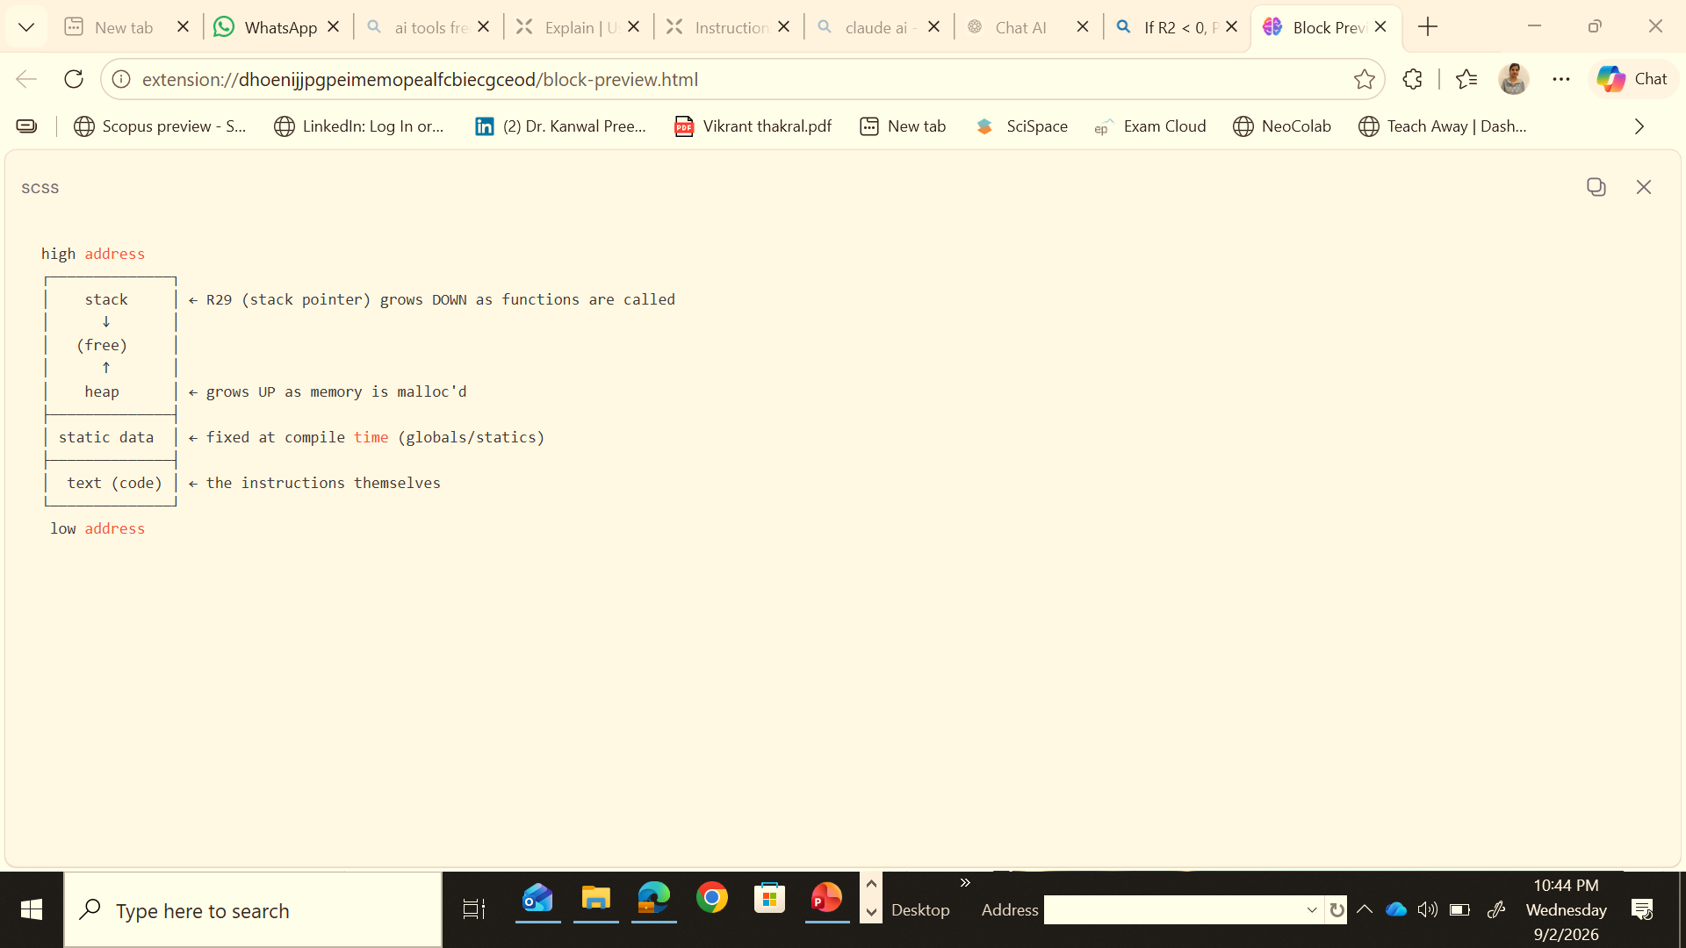
Use of Main Memory by a Program
Instructions (code, text)
Data used in different ways
  Stack allocated
  Heap allocated
  Statically allocated
text
data
stack
heap
Use of memory addresses

Slide 15
Stack Allocated Variables
Space allocated on function call, reclaimed on return
Addresses calculated and used by compiler, relative to the top of stack, or some other base register associated with the stack
Growth of stack area is thus managed by the program, as generated by the compiler

Slide 16
Heap Allocated Variables
Managed by a memory allocation library
Functions like malloc, realloc ,free
Get `linked’ (joined) to your program if they are called
Executed just like other program functions
What about growth of the heap area?
  Managed by the library functions

